Slide 1
Spring boot AWS SQS

Slide 2
AWS SQS (Simple Queue Service)
Queuing service
Use for send, receive, and store messages
Two types of SQS
FIFO
Standard
Notes:
https://aws.amazon.com/sqs/

Slide 3
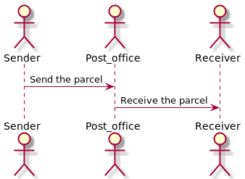
AWS SQS (Simple Queue Service)
Notes:
https://aws.amazon.com/sqs/

Slide 4
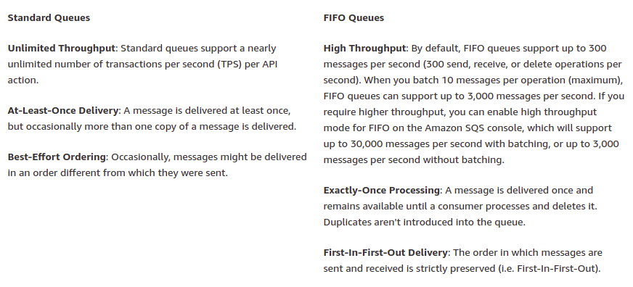
AWS SQS (Simple Queue Service)
Notes:
https://aws.amazon.com/sqs/

Slide 5
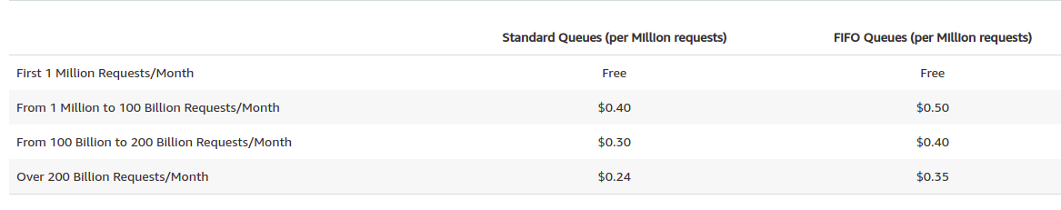
AWS SQS PRICING
Pay only for what you use
Notes:
https://aws.amazon.com/sqs/
https://aws.amazon.com/sqs/pricing/

Slide 6
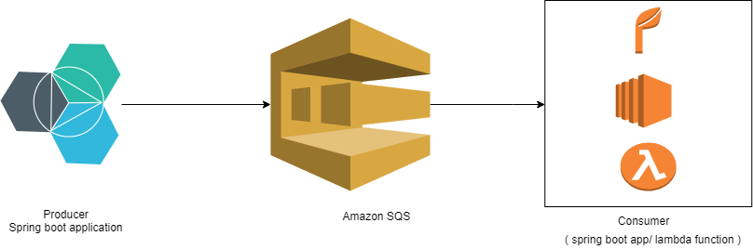
AWS SQS (Simple Queue Service)
Notes:
https://aws.amazon.com/sqs/

Slide 7
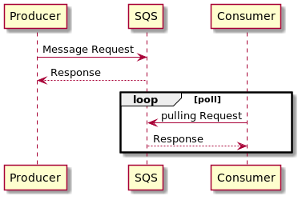
AWS SQS (Simple Queue Service)

Slide 8
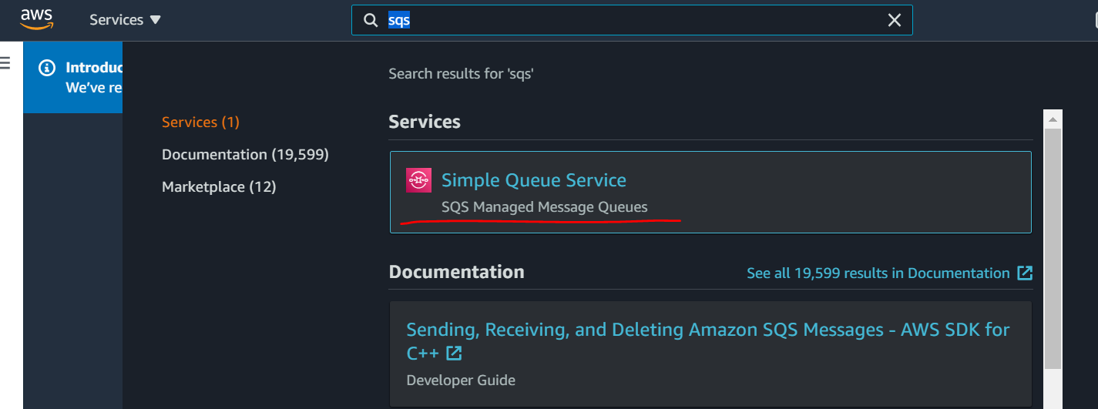
Spring boot AWS SQS
Notes:
https://aws.amazon.com/sqs/

Slide 9
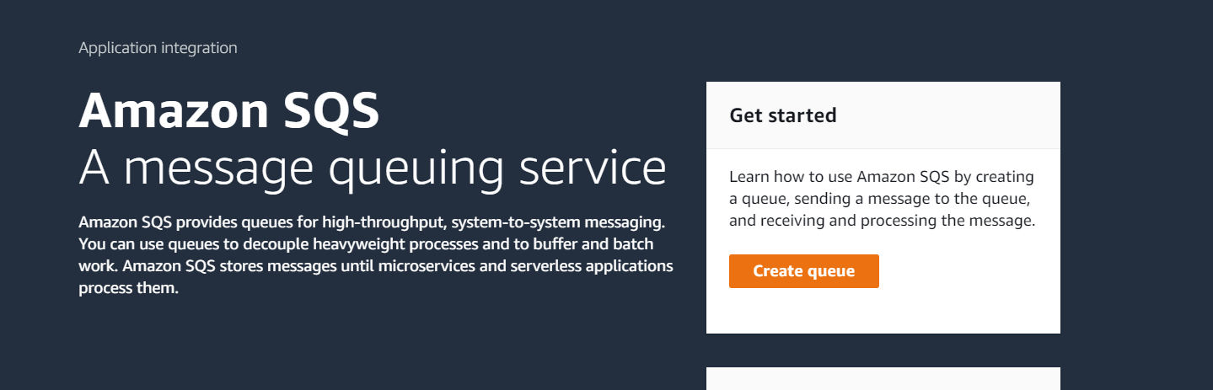
Spring boot AWS SQS
Notes:
https://aws.amazon.com/sqs/

Slide 10
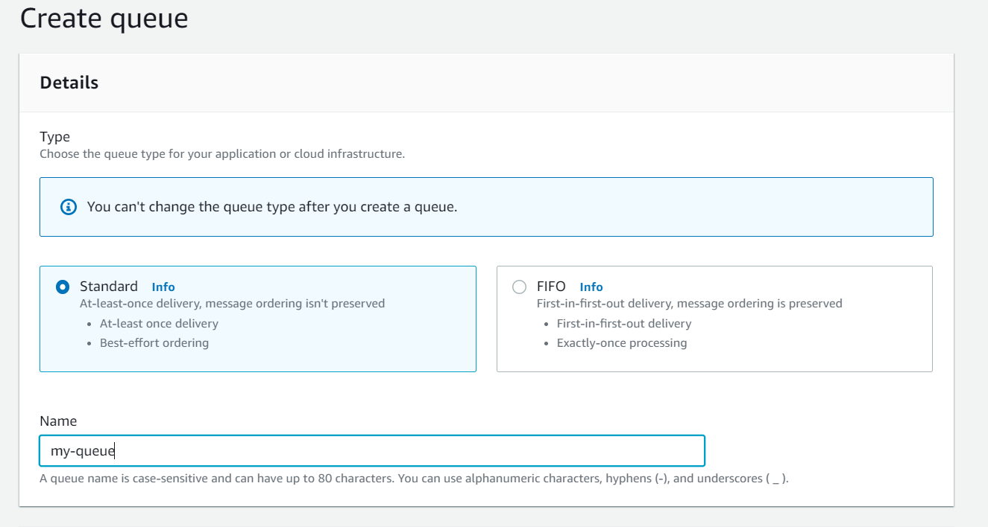
Spring boot AWS SQS
Notes:
https://aws.amazon.com/sqs/

Slide 11
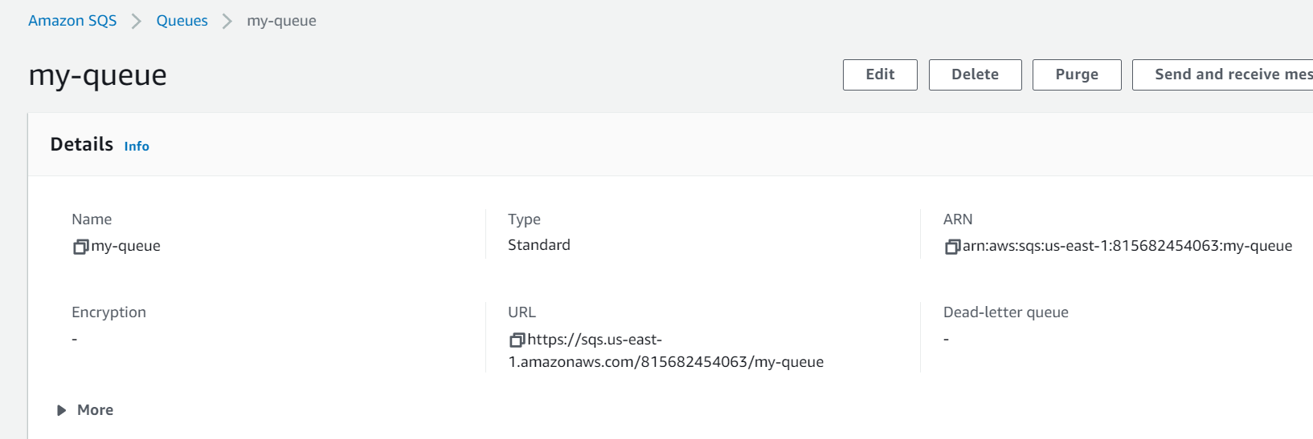
Spring boot AWS SQS
Notes:
https://aws.amazon.com/sqs/

Slide 12
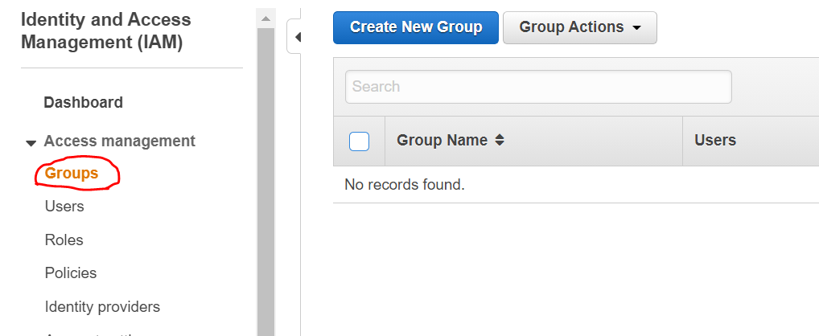
Step 2- Creating IAM group to access the queue
Notes:
https://aws.amazon.com/sqs/

Slide 13
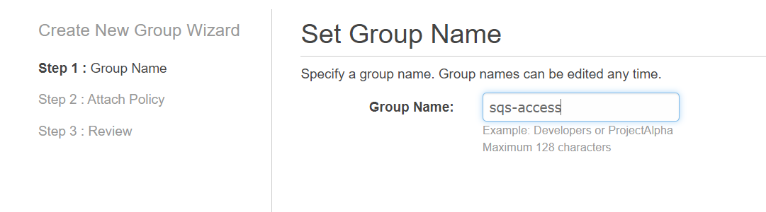
Step 2- Creating IAM group to access the queue
Notes:
https://aws.amazon.com/sqs/

Slide 14
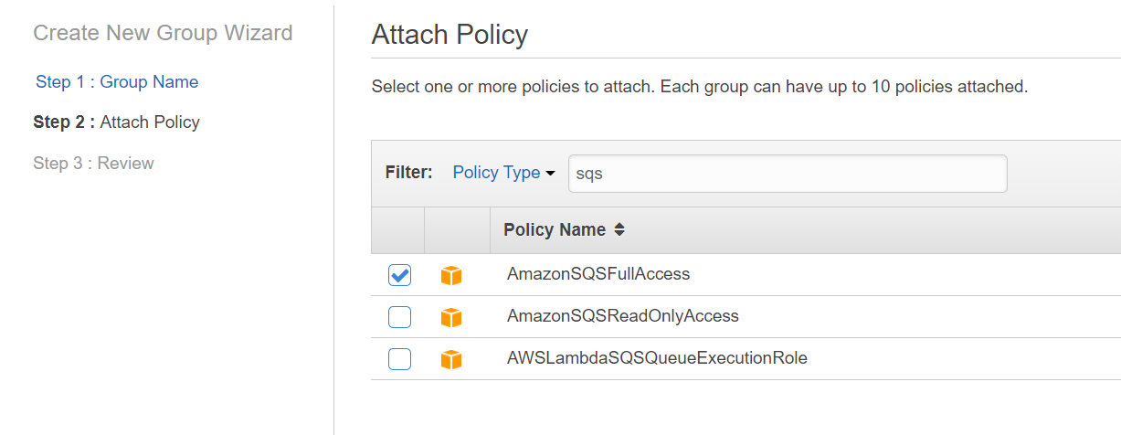
Step 2- Creating IAM group to access the queue
Notes:
https://aws.amazon.com/sqs/

Slide 15
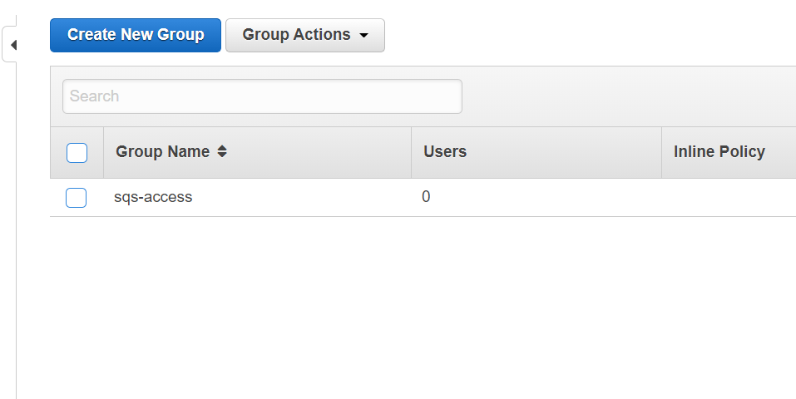
Step 2- Creating IAM group to access the queue
Notes:
https://aws.amazon.com/sqs/

Slide 16
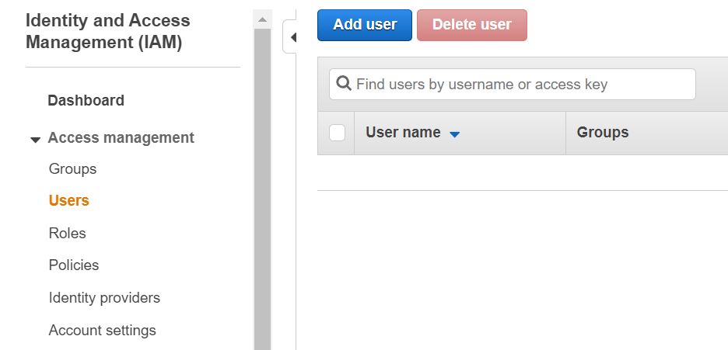
Step 3: Create the IAM user and attach it to our IAM group
Notes:
https://aws.amazon.com/sqs/

Slide 17
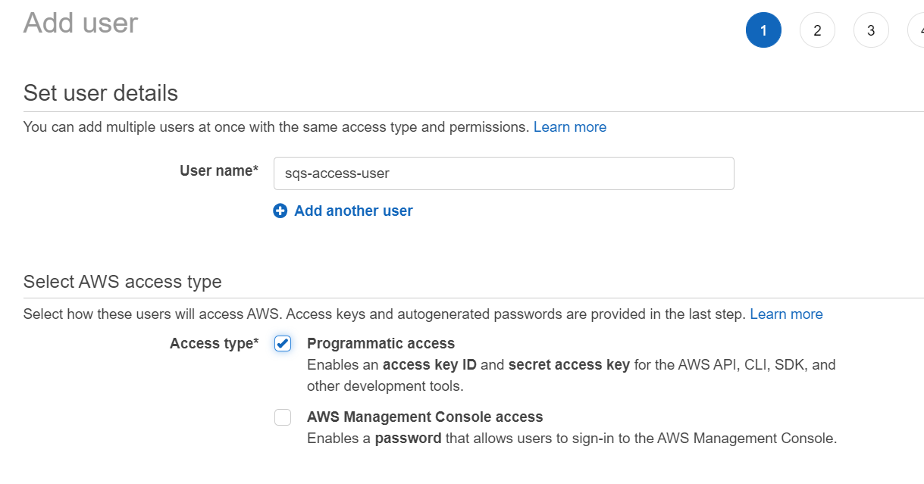
Step 3: Create the IAM user and attach it to our IAM group
Notes:
https://aws.amazon.com/sqs/

Slide 18
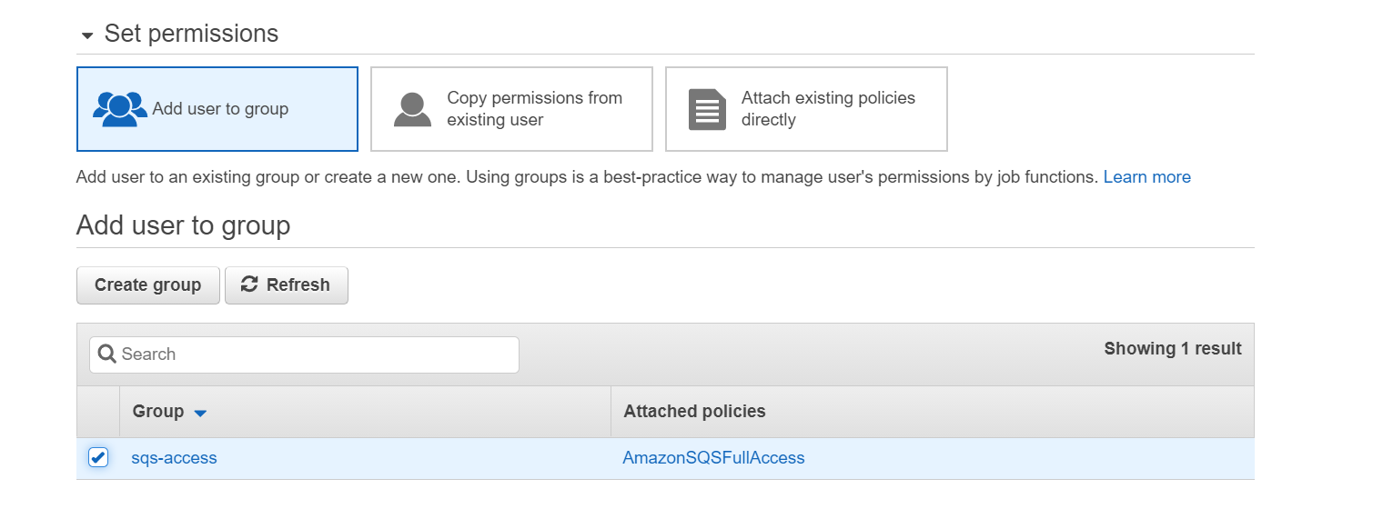
Step 3: Create the IAM user and attach it to our IAM group
Notes:
https://aws.amazon.com/sqs/

Slide 19
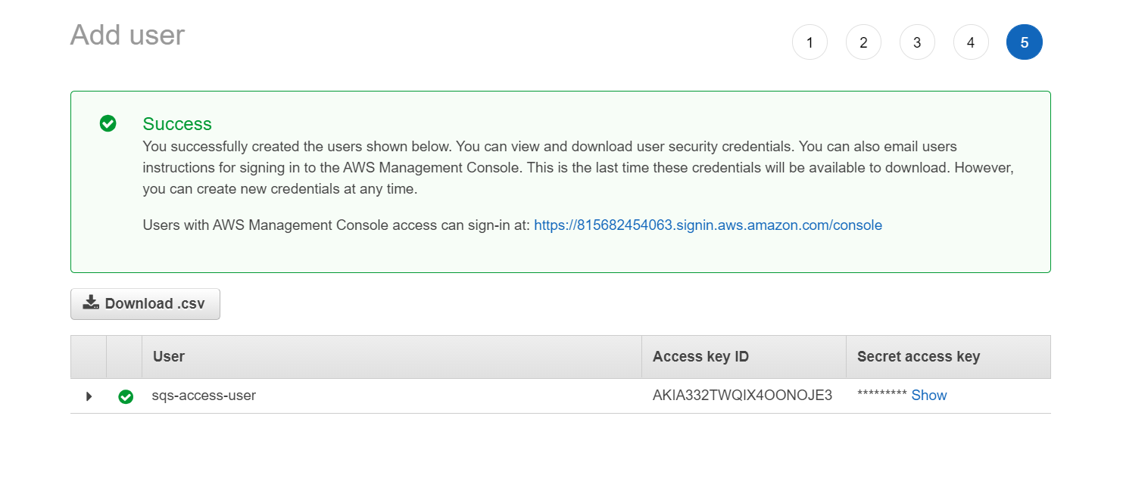
Step 3: Create the IAM user and attach it to our IAM group
Notes:
https://aws.amazon.com/sqs/

